Slide 1

1
Bangladesh Army University of Science and Technology(BAUST), Saidpur
GROUP MATE:
SUPERVISED BY:
Anindya Halder (200101010)
Mst. Faujia Akter (200101035)
Most. Joiariya Zannath (200101065)
Fatema Tuz Zohra
Assistant professor
Department of Computer
Science and Engineering(CSE)

Slide 2
2
Bengali Word Assimilation Integrating Using Deep Learning Methods

Slide 3
3
Content
Introduction
Literature Review
Problem Definition
Objective
Methodology
Flow Chart
Tools and Technology
Dataset Description
Model implementation
Accuracy
Performance Comparison
Result Analysis
Future work
Limitation
Conclusion
References
Bengali Word Assimilation Integrating Deep Learning Methods

Slide 4
4
Introduction
Natural language processing
Classify (Text document)
Deep Learning model
Bengali Word Assimilation Integrating Deep Learning Methods

Slide 5
5
Literature Review
An Innovative Approach of Bangla Text Summarization by Introducing Pronoun Replacement and Improved Sentence Ranking(2017)[1]
Proposed method:
MarKov chain model and Hidden Markov model
Result:
Precision 58%, Recall 51%, F1 Score 48%, Accuracy 61%
Limitation:
Dataset have only 3400 Unicode text
Bengali Word Assimilation Integrating Deep Learning Methods

Slide 6
6
Literature Review(Contd.…)
Using Social Networks to Detect Malicious
Bangla Text Content.[2]
Proposed method:
The dataset has formatted into 2 columns: Text & Status. Consists of 1965 instances including 646 spam and 1319 non spam instances.
Result:
Naïve Bayes: 82.44%
Limitation:
Potential for increased accuracy through combined classifications.
New area for spam analysis of Bangla texts.
Bengali Word Assimilation Integrating Deep Learning Methods

Slide 7
7
Literature Review(Contd.…)
Empirical Study of Online News Classification Using
Machine Learning Approaches.[3]
Proposed method:
Divided into 8 categories: Social, World News, Current, Events, Sport, Economics, Entertainment, Art, Politics.
Result:
Naïve Bayes : 72%
SVM: 74%
Limitation:
Limited resource .
Bengali Word Assimilation Integrating Deep Learning Methods

Slide 8
8
Literature Review(Contd…)
Hybrid Text Summarizer for Bangla Document.[3]
Proposed method:
Divided into 4 category: Accident, Economics, Entertainment, Politics.
Result:
The proposed system performs with an average of 0.77% Recall Score,0.57 %Precision Score, and 0.64% F-measure Score.
Limitation:
Used small dataset.
Benchmark dataset
Bengali Word Assimilation Integrating Deep Learning Methods

Slide 9
9
Problem Definition
Challenging to execute
Difficulty in implementing
Limited Dataset
Difficulty to earn better accuracy
Bengali Word Assimilation Integrating Deep Learning Methods

Slide 10
10
Objective
Implementing deep learning algorithm
Classify the Bangla comments
Accurate Categorization
Advance the field of Bangla NLP
Analyzing public opinion and understanding user feedback in Bengali social media posts
Bengali Word Assimilation Integrating Deep Learning Methods

Slide 11
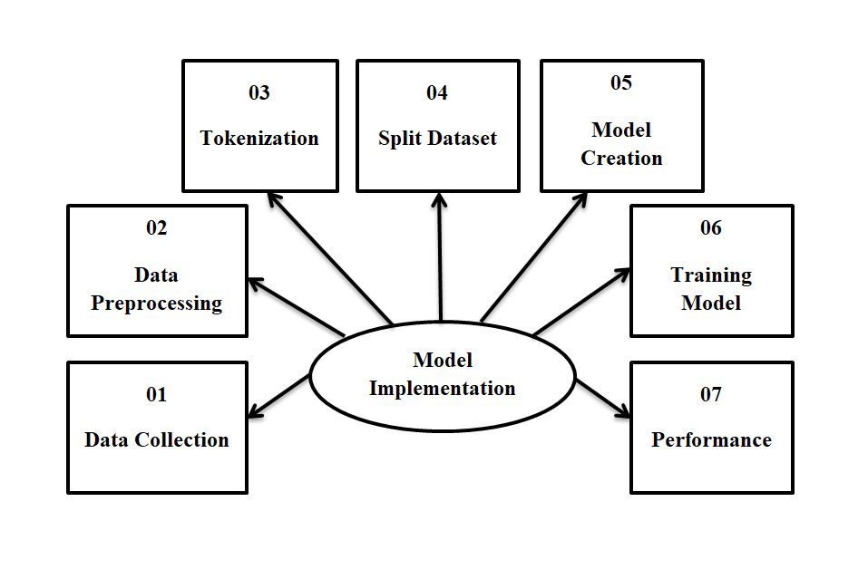
11
Methodology
Fig-1: Methodology
Bengali Word Assimilation Integrating Deep Learning Methods

Slide 12
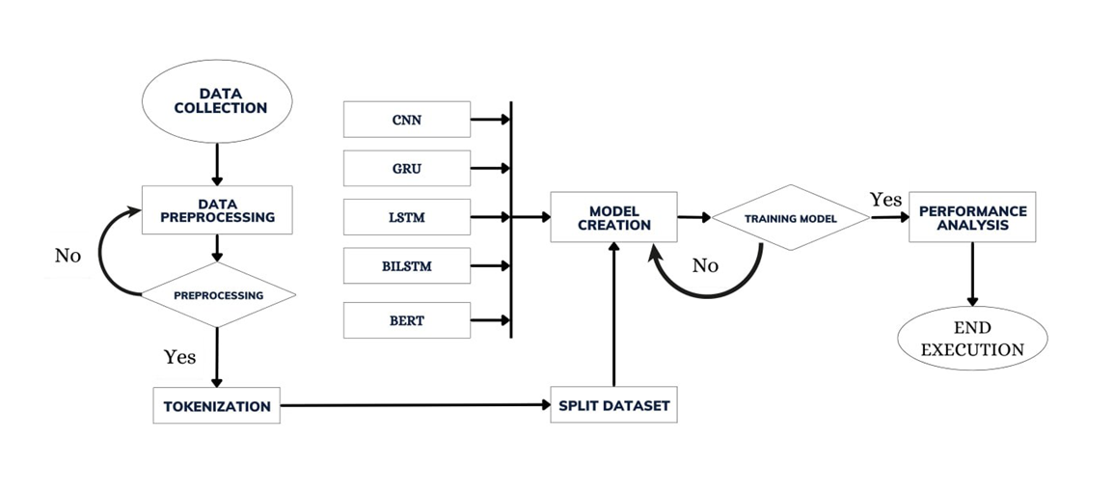
12
Flow Chart
Fig-2: Flow Chart
Bengali Word Assimilation Integrating Deep Learning Methods

Slide 13
13
Tools & Technology
Google Colaboratory
Google Drive
Deep learning tools
Bengali Word Assimilation Integrating Deep Learning Methods

Slide 14
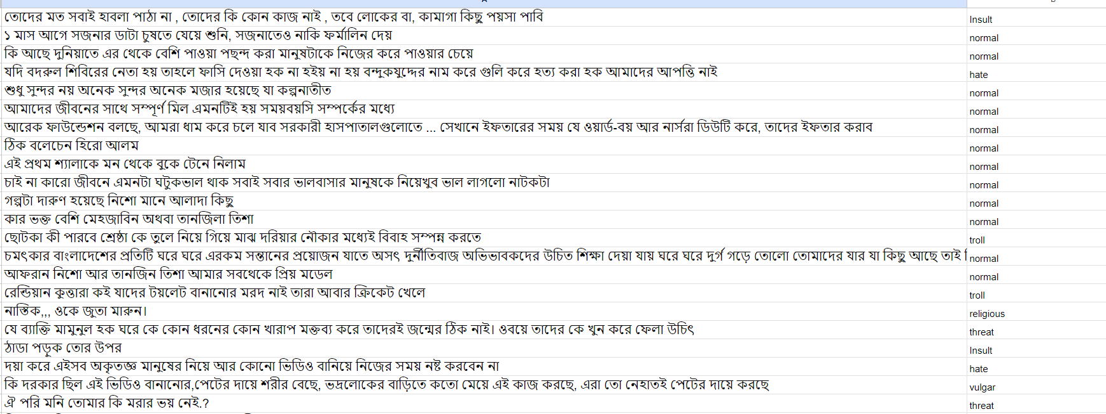
14
Dataset Description
Dataset Snapshot
Dataset class level
Religious
Insult
Threat
Vulgar
Hate
Troll
Normal
Total data 16053
Bengali Word Assimilation Integrating Deep Learning Methods

Slide 15
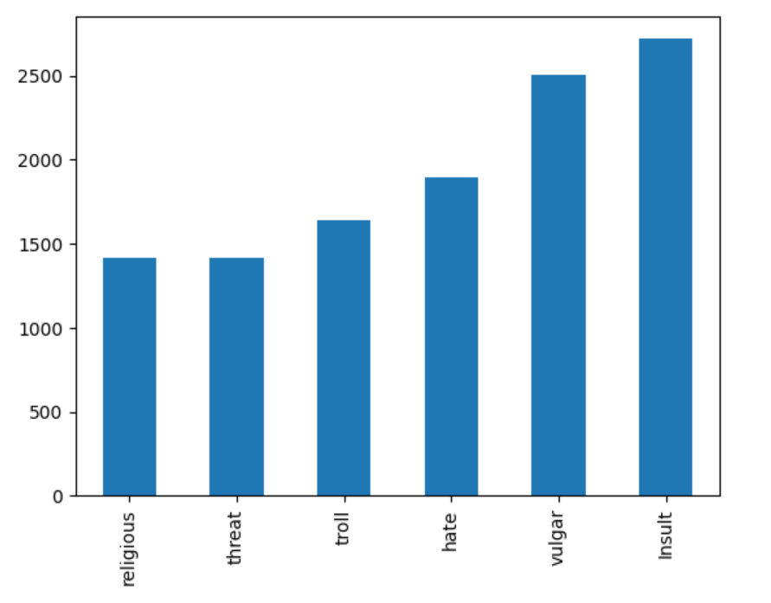
15
Dataset Description(Contd.…)
Fig-3: Class level of dataset
Bengali Word Assimilation Integrating Deep Learning Methods

Slide 16
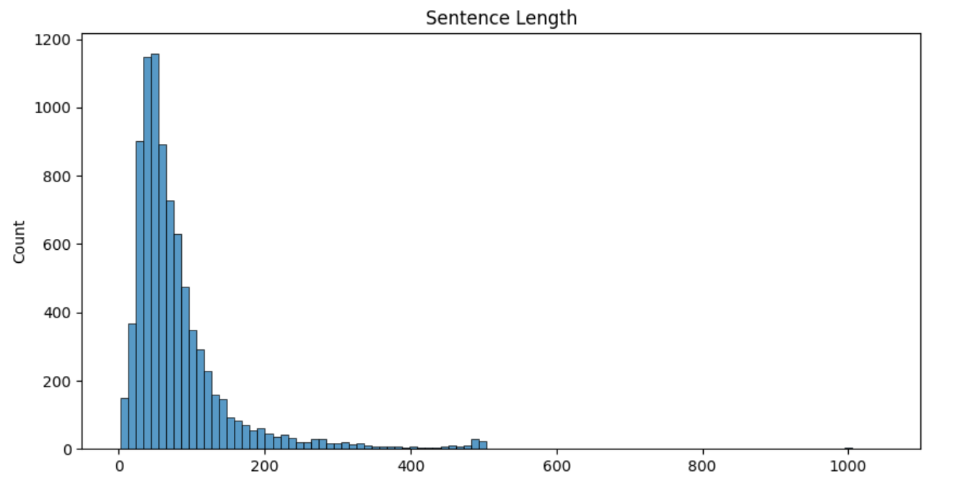
Dataset Description(Contd.…)
16
Fig-4: Sentence length of dataset
Bengali Word Assimilation Integrating Deep Learning Methods

Slide 17
17
Model Name
CNN (Convolution Neural Network)
GRU (Gated Recurrent Unit)
LSTM (Long Short Term Memory)
BiLSTM(Bidirectional Long Short Term Memory)
BERT(Bidirectional Encoder Representations From Transformer)
Bengali Word Assimilation Integrating Deep Learning Methods

Slide 18
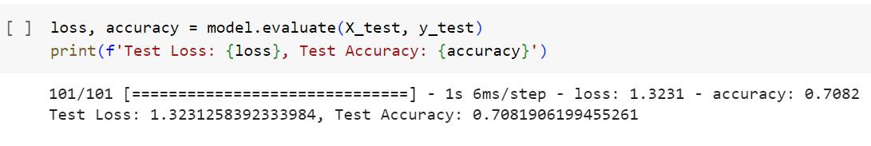
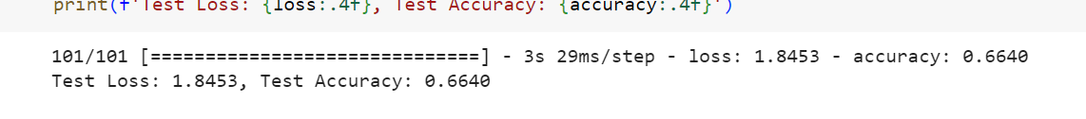
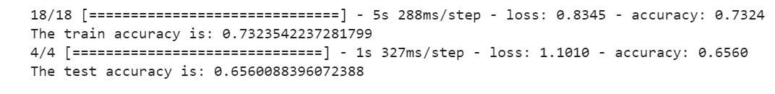
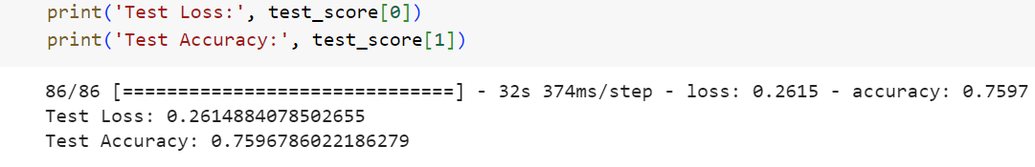
18
Accuracy
CNN – 71%
GRU – 67%
BiLSTM – 66%
LSTM+BERT – 76%
Bengali Word Assimilation Integrating Deep Learning Methods

Slide 19
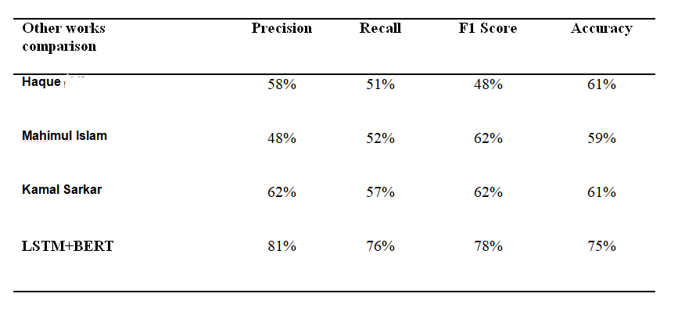
Performance Comparison
19
Here we represent a table with comparing with other research works deliberately done by researchers:
[1]
[8]
[4]
Table 1: Performance Comparison
Bengali Word Assimilation Integrating Deep Learning Methods

Slide 20
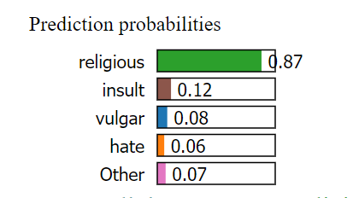
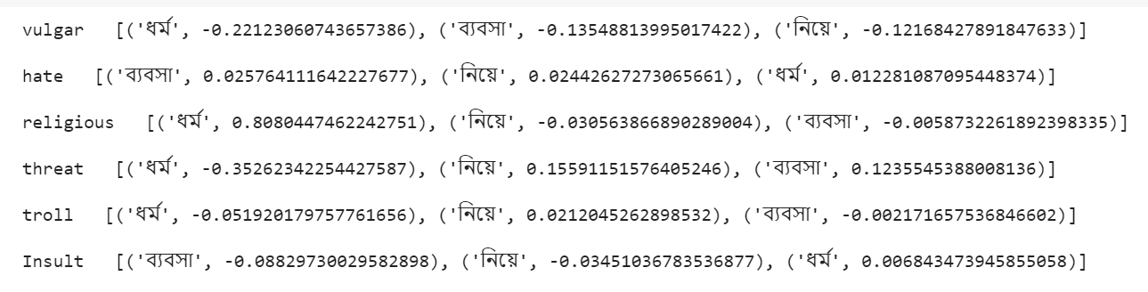
Result Analysis
20
Sentence:'ধর্ম নিয়ে ব্যবসা'
Bengali Word Assimilation Integrating Deep Learning Methods

Slide 21
21
Future Work & Limitation
In the future, our work offering opportunities to make a positive impact in several ways:
Developing user-centric applications
Social media and online platforms
Limitation:
For better accuracy we will implement more deep learning algorithm in future
Bengali Word Assimilation Integrating Deep Learning Methods

Slide 22
Conclusion
22
It aimed to develop a Bangla text categorization model using deep learning techniques. While successful, the accuracy (75% across 7 categories)
Complexities like limited resources and unique language features create difficulties for categorization models
At last We want to say that as Bengalis, it is essential for us to do a lot of work regarding our Bengali language.
Bengali Word Assimilation Integrating Deep Learning Methods

Slide 23
23
References
[1] P. S. Haque, M.M and Z. Begum, “An innovative approach of bangla text summarization by introducing pronoun replacement and improved sentence ranking,” Journal of Information Pro cessing Systems, vol. 13:4,2017, pp. 752–777.
[2] Islam, T., S. Latif, and N. Ahmed. “Using social networks to detect malicious bangla text content.” in 2019 1st International Conference on Advances in Science, Engineering and Robotics Technology (ICASERT).(IEEE 2018). pp.8-16.
[3] U. Suleymanov, S. Rustamov, M. Zulfugarov, O. Orujov, N. Musayev, and A. Alizade, “Empirical study of online news classification using machine learning approaches,” in 2018 IEEE 12th International Confer-ence on Application of Information and Communication Technologies (AICT). (IEEE 2019), pp. 1–6.
[4] M. Islam, F. N. Majumdar, A. Galib, and M. M. Hoque, “Hybrid text summarizer for bangla document,” Int J Comput Vis Sig Process, vol. 1, no. 1,2020, pp. 27–38.
Bengali Word Assimilation Integrating Deep Learning Methods

Slide 24
Limitations(Contd…)
24
[5] K. Sarkar, “Bengali text summarization by sentence extraction,” arXiv preprint arXiv:1201.2240, 2012,pp 5-10
[6] J. Liu, D. J. Hughes, and Y. Yang, “Unsupervised extractive text summarization with distance-augmented sentence graphs,” in 44th International ACM SIGIR Conference on Research and Development in Information Retrieval, 2021, pp. 2313–2317.
[7] A. Dhar, N.S. Dash, K. Roy, Classification of bangla text documents based on inverse class frequency, in 2018 3rd International Conference on Internet of Things: Smart Innovation and Usages (IoT-SIU) (IEEE, 2018), pp 1–6
[8] K. Sarkar, “A keyphrase-based approach to text summarization for english and bengali documents,” International Journal of Technology Diffusion (IJTD), vol. 5, no. 2, pp. 28–38, 2014.
Bengali Word Assimilation Integrating Deep Learning Methods

Slide 25
THANK YOU
24
Bengali Word Assimilation Integrating Deep Learning Methods

